Slide 1
Game Theory and Artificial Intelligence Design
tAd cOrDlE, NoLaN LuM

Slide 2
Objectives
To design and develop an AI to play a game developed in-house.
To explore commonly used concepts and theories associated with game theory.
To become familiarized with best practices and common procedures used with source control systems.

Slide 3
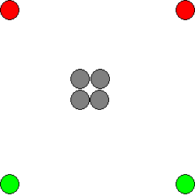
Overview – Blob Wars
The game starts with 2 player-controlled pieces per player.
Grey spaces are immovable and neutral.

Slide 4
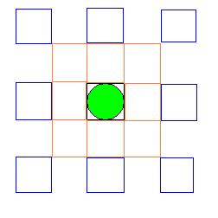
Overview – Blob Wars
Each piece can move to the 9 spaces adjacent, cloning the piece.
It can also jump 2 spaces, but this consumes the original piece.

Slide 5
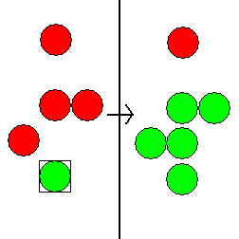
Overview – Blob Wars
Landing a player-controlled piece next to opponent pieces converts the pieces adjacent.
Note that only the 9 pieces adjacent to the piece are converted.

Slide 6
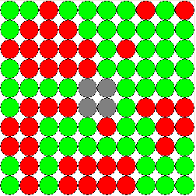
Overview – Blob Wars
The game ends when the board is completely full.
Or, when one player has no moves available.

Slide 7
Designing the AI
Several problems needed to be solved in the design of the AI:
Ranking and categorization of possible moves.
Move search algorithm.
Ranking and categorization of board states.
Moves are explored in a tree-like structure, utilizing a modified depth-first search.

Slide 8
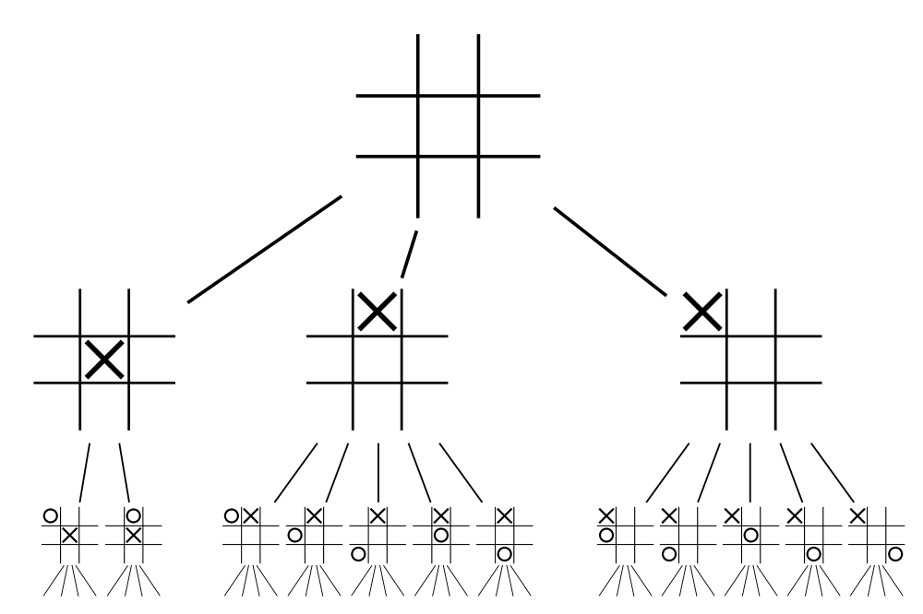
Designing the AI
Exploring the game tree:
Each node is a possible state.
Each branch represents a move.
Each complete level is a “ply”.
Depth First Search
Moves are searched up to a certain “depth”, then exploration proceeds sideways.
An example game tree for tic-tac-toe.

